Slide 1
Assessing member states’ investment needs and financing capacities for water supply & sanitation
OECD and European Commission - Directorate General Environment
Xavier Leflaive, 21 May 2019
DANUBE WATER CONFERENCE
Preliminary findings subject to adjustments
Notes:
Objective and programme of work:
Identify EU member countries facing the most severe challenge in financing investment needs for water supply, sanitation and flood protection by 2050

Slide 2
Scope
Water-related investments to 2050
Water supply
Wastewater collection and treatment
Flood protection
Pending issues
Compliance with Water Framework Directive
Climate change
Contaminants of emerging concern

Slide 3
Baseline (2011-2015)

Slide 4
Total annual expenditures for water supply and sanitation per member state
Note: Likely overestimate of supply-related expenditures (and corresponding underestimate of sanitation) in countries where wastewater-related charged are included in the water bill. Total expenditure for Finland, Croatia and Sweden are known to be underestimated due to data limitations.
Source: OECD analysis based on EUROSTAT (General government expenditure by function, Final consumption expenditure on environmental protection services by institutional sector, Final consumption expenditure of households by consumption purpose, Mean consumption expenditure by detailed COICOP level).
million EUR, 2011-15 annual average

Slide 5
Per capita annual expenditures for water supply and sanitation per member state
Note: Likely overestimate of supply-related expenditures (and corresponding underestimate of sanitation) in countries where wastewater-related charged are included in the water bill. Total expenditure for Finland, Croatia and Sweden are known to be underestimated due to data limitations.
Source: OECD analysis based on EUROSTAT (General government expenditure by function, Final consumption expenditure on environmental protection services by institutional sector, Final consumption expenditure of households by consumption purpose, Mean consumption expenditure by detailed COICOP level).
EUR, 2011-15 annual average

Slide 6
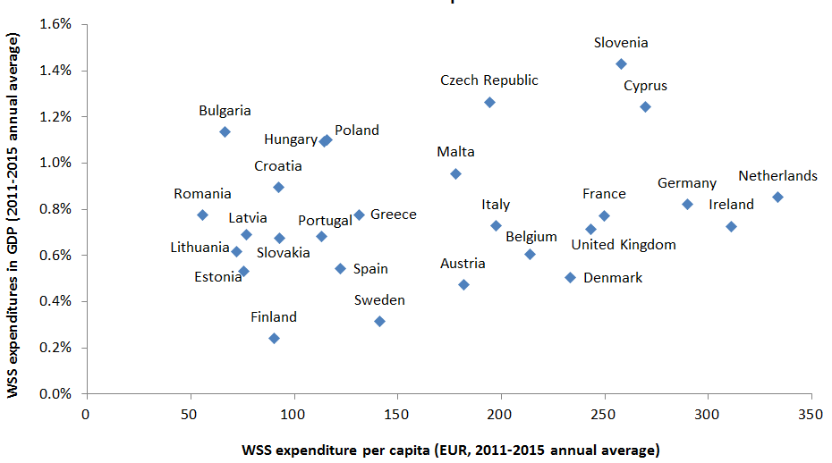
Macroeconomic affordability
Source: OECD analysis based on EUROSTAT (WSS-related public and household expenditures, GDP, population).

Slide 7
PROJECTIONS (2015-2030)

Slide 8
A note on method
Current levels of expenditure: Eurostat data, combining a range of data sets
Overestimation of WS vis-à-vis WW
OECD split between OPEX and CAPEX
Business-as-usual scenario
Driven by urban population growth
Additional scenarios
For water supply: efficiency, access
For sanitation: compliance (convergence with compliant countries)

Slide 9
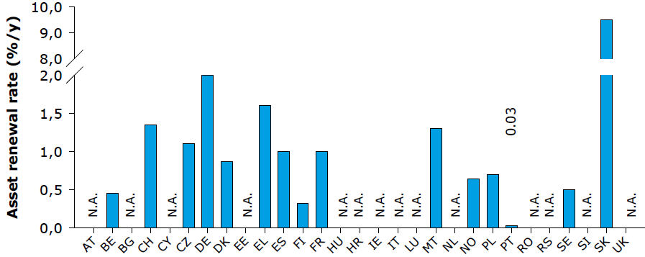
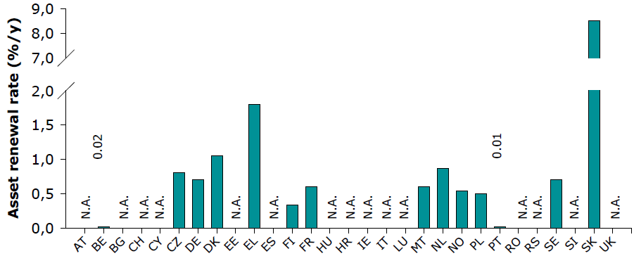
Drivers of investment needs Asset renewal rate
For water supply
For wastewater
Source: EurEau (2017). Data from 2012-2015, depending on countries

Slide 10
Per capita cumulative additional expenditures by 2030: BAU + Compliance + efficiency
Luxembourg: EUR 2928 (BAU: 2782; WS:146; WW: 0)
Source: OECD analysis based on European Commission and Eurostat data
EUR

Slide 11
FINANCING OPTIONS

Slide 12
Sources of finance for water supply and sanitation services per member state
Household expenditure data unavailable
Source: OECD analysis based on EUROSTAT (General government expenditure by function, Final consumption expenditure on environmental protection services by institutional sector, Final consumption expenditure of households by consumption purpose, Mean consumption expenditure by detailed COICOP level).
2011-15 annual average

Slide 13
Share of EU transfers in estimated total expenditures for WSS per country
Note: It is assumed that EU transfers are always channelled through domestic budgets of each member states and that they are, therefore not additional to government expenditures .
Source: OECD analysis based on EUROSTAT (for past estimated expenditures), European Commission Directorate-General for Regional and Urban Policy (Open Data Portal for European Structural and Investment Funds).
2011-15 annual average

Slide 14
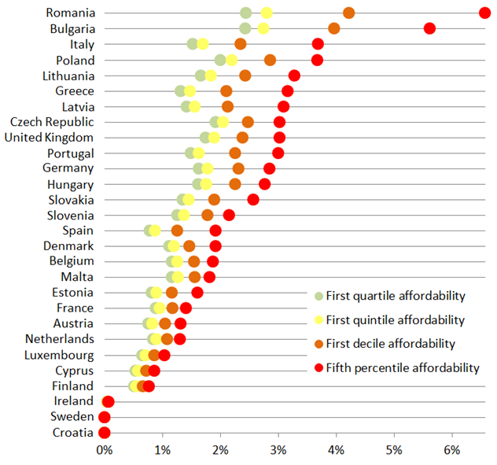
Share of WSS expenditures in households’ disposable income
Note: Lack of household expenditure data for Croatia and Sweden.
Source: OECD analysis based on EUROSTAT (household expenditures and income data)
2011-15 annual average

Slide 15
Options to bridge the gap This is not all about more money
Minimise investment needs
Avoid building future liabilities
Enhance operation of existing assets
Make the best use of available resources
Plan and set priorities
Explore nature-based solutions (UK, EIB…)
Enhance the quality of investment
Policy coherence
The benefit of technical innovation
Crowd in new sources of finance
Beneficiaries (property developers)
Domestic commercial finance (blending)

Slide 16
Revised projections on investment needs to comply with UWWTD (2015-2030)

Slide 17
Per capita cumulative total expenditures by 2030 for compliance with UWWTD

Slide 18
Per capita cumulative additional investment by 2030 to comply with UWWTD

Slide 19
Per capita cumulative reinvestment costs by 2030 for compliance with UWWTD

